Slide 1
Getting Skills Right
A dashboard

Slide 2
The project
Priorities of Adult Learning Scoreboard
Create an online tool allowing countries to assess and benchmark themselves
Provide a synthetic overview of the readiness of adult learning systems to respond to the challenges of changing skill needs

Slide 3
The data
Challenges | Dimension | Subdimensions
 | Urgency of training need | Population ageing | Automation & structural change | Adult skills | Labour market imbalances
 | Participation | Employers | Individuals
 | Inclusiveness | Participation gap - specific demographics | Participation gap - specific employment status | Participation gap - specific contract status/ work place
Responses | Dimension | Subdimensions
 | Investment | Government | Employers | Individual
 | Alignment with skill needs | Assessment of skill needs | Training for future skill needs | Training for workers at risk
 | Quality and effectiveness of training | Monitoring & Certification | Usefulness & Effectiveness
 | Flexibility and Guidance | Flexibility of provision | Use of career guidance services
7 dimensions
Divided into 2 categories : Challenges and Responses
18 Sub-dimensions overall
49 indicators

Slide 4
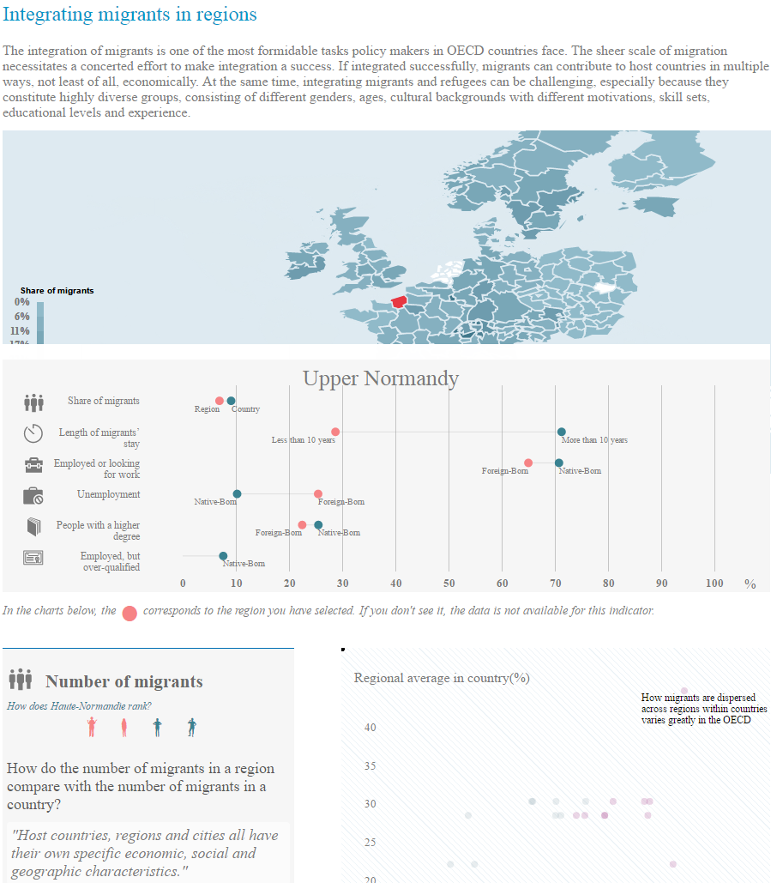
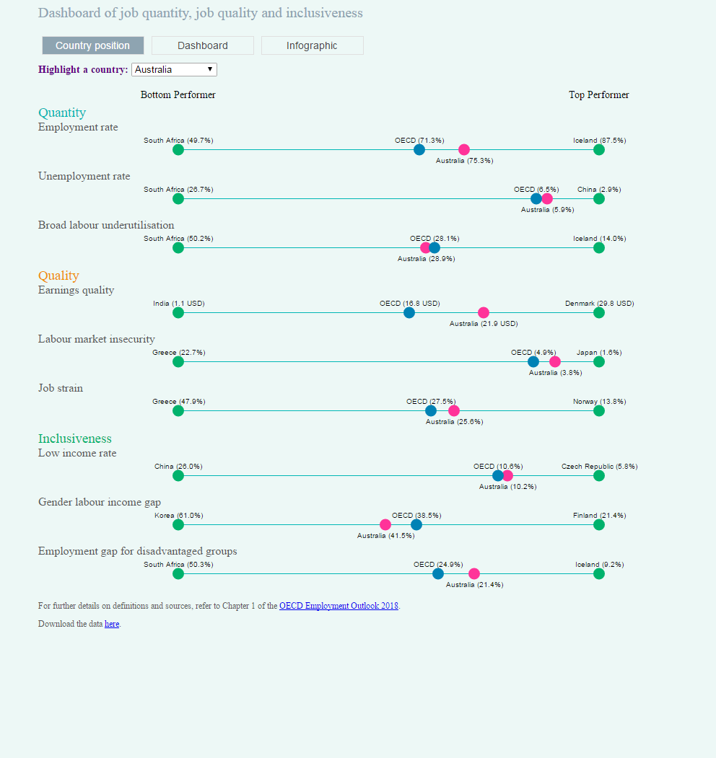
Which format?
Storytelling
Descriptive
A combination of both?
Provide a synthetic overview of the readiness of adult learning systems to respond to the challenges of changing skill needs
Create an online tool allowing countries to assess and benchmark themselves

Slide 5
Chart types
Re-using the templates
International comparison
Country view
across the 7 dimensions
across the 7 dimensions
From multiple to one
Per (sub-) dimension
Per (sub-)dimension
Same with highlight
Per indicator
Per indicator
Same with hightlight

Slide 6





Visual explorations
Across dimensions
Spider chart
Parallel Coordinates
Circular packing
Stacked bar
Grouped barplot
Combined with
Small multiples
One occurrence of the chart per country
Icon source: https://www.data-to-viz.com

Slide 7



Visual explorations
Per (sub) -dimension
Barplot
Lollipop
Optional :
The possibility to compare across dimensions or sub-dimensions wouldn’t be provided at lower levels
Scatterplot

Slide 8

Visual explorations
Per indicator
Barplot
Lollipop
Alternative :
Present the sub-dimensions at the same time as their indicators
Marimekko

Slide 9
Website structure
Homepage
Homepage
Country
Quick introduction
Homepage aims at allowing quick country comparisons of country performances
The explanation section could be either brief and presenting the project highlights, either extensive with a real story and a presentation of the various dimensions.
International comparison across the 7 dimensions
Explanation…
…Explanation…
…Explanation…

Slide 10
Website structure
Country page
Homepage
Country
Dimension 1
Dimension 2
Dimension 3
Dimension …
Dimension 1 chart
Reached by clicking on one of the chart on the homepage
All charts highlight the same country
Click on a country in the chart to see it highlighted.
Sub dimension 1
Indicator 1
…
Sub dimension 2
…

Slide 11
Hosting
Where is it hosted?
Communication plan?
Link to similar projects?
Campaign integration

Slide 12

Storytelling – real life example

Slide 13
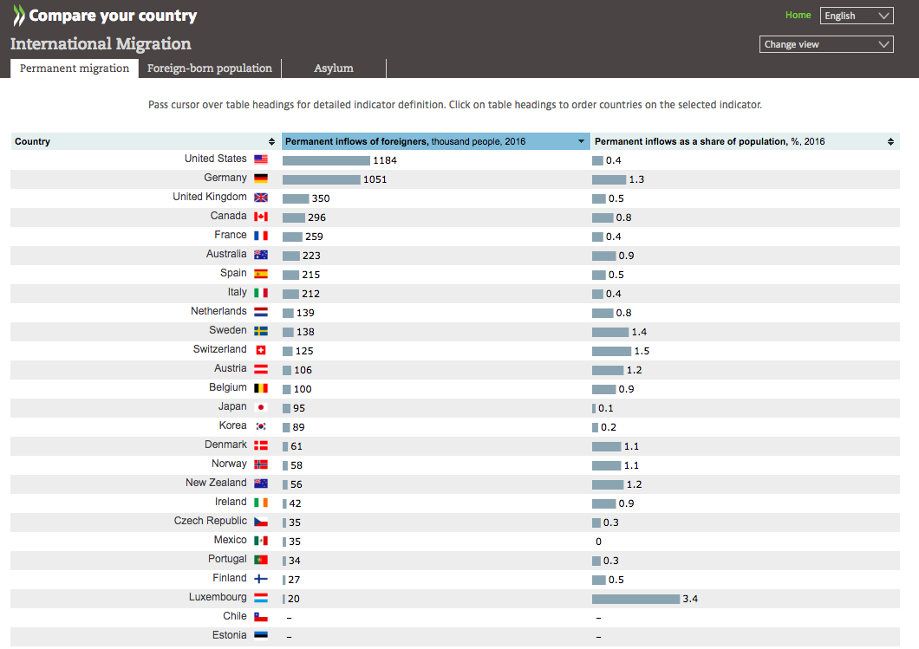
Compare your country
Easy to implement
Allow easy comparison
Modulable

